Slide 1


Probabilities
Dr. Ahmad S. Tarawneh

Slide 2
Outline
Introduction
Discrete Random variables
Probability mass function
Mean, Variance and Standard deviation
Continuous Random Variables
Probability Density Function
Expectation
Cumulative Distribution Function

Slide 3
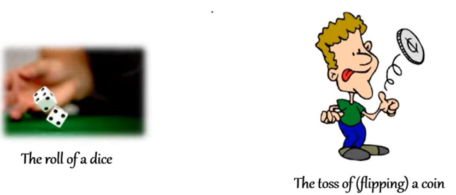
Random Experiment
A Random experiment is any experiment, with known outcomes, that its outcome cannot be determined with a certainty until the experiment is conducted (run)
For example, in a dice we know the outcomes, 1-6, but we are not totally sure which one will appear

Slide 4
Sample Space
A sample space, S, is the set of all possible outcomes of a random experiment
A sample space is discrete if it consists of a countable set of outcomes
A sample space is continuous if it contains an interval (uncountable) set of outcomes

Slide 5

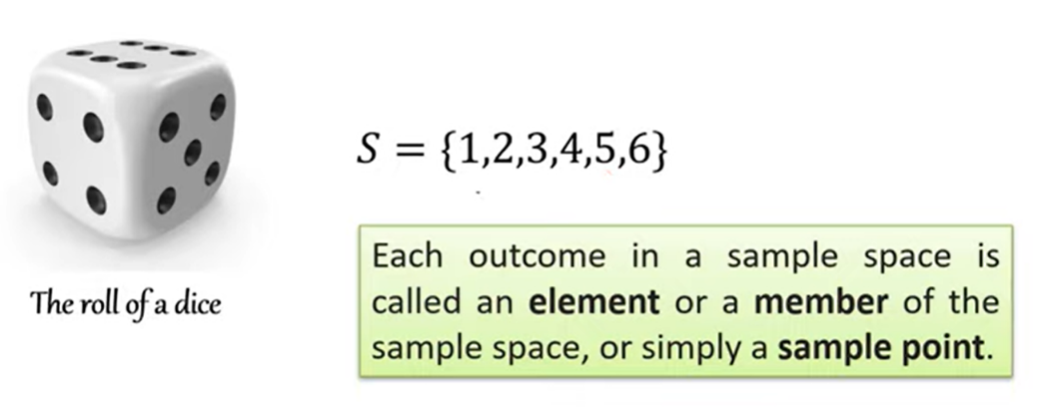
Cont.
A sample space is discrete if it consists of a countable set of outcomes

Slide 6
Example
What is the Sample space, S, for a random experiment of flipping a coin two times?

Slide 7

Example
What is the Sample space, S, for a random experiment of flipping a coin two times?
Solution:
$$S=\{HH, HT, TH, TT\}$$

Slide 8












Tree diagram
This can be presented in what is called a Tree diagram
$$H$$
$$HH$$
$$H$$
$$T$$
$$HT$$
$$H$$
$$TH$$
$$T$$
$$T$$
$$TT$$
$$S=\{HH, HT, TH, TT\}$$

Slide 9
Practice
What is the Sample space, S, for a random experiment of flipping a coin and rolling a dice?
Present it using the tree diagram………..

Slide 10

Example 2
In continuous the story is a bit different
Consider the experiment of measuring the heights of all adults in a factory
$$S=\left\{x \right| x>100\}$$
You might have prior information that no one is taller than 200 CM, then, S will be
$$S=\left\{x \right| 200>x>100\}$$

Slide 11
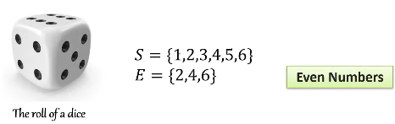

Event (E)
A result of none, one or more outcomes in the sample space
An event is a subset of the sample space of a random experiment
$$E⊆S$$
For example, in a dice-rolling experiment:
An event of having 7 is not possible, out of the sample space
This is called the null event
The event of having {1 or 2 or 3 … or 6} is called a certain event

Slide 12
Probability
Probability is a measure of the likelihood, or chance, that an outcome of a random experiment will occur
For example, "there is a chance of 70% that a costumer will enter the shop in the next hour"
This statement quantifies the possibility of having a costumer the next hour

Slide 13
Cont.
The likelihood of an outcome is quantified with a number from the interval [0-1], or [0-100]%.
A higher number indicates that the outcome is more likely to occur, while a low number means the outcome is less likely
0 means the outcome will not occur
1 means the outcome is certain to

Slide 14
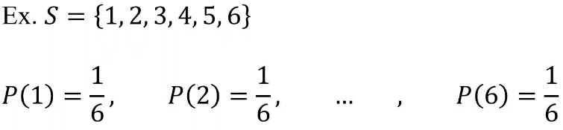

Equally likely outcomes
If a sample space, $S$, contains $N$ outcomes that are equally likely, then the probability for each event is $1/N$
In tossing a fair coin the probability for each outcome is $1/2$
In rolling a fair die the probability for each outcome is $1/6$

Slide 15

Cont.
So, in the equally likely outcomes
If $S$ is the sample space, $E$ is an event and $E⊆S$
$P\left(E\right)=\frac{Number of outcomes in (E)}{Total number of outcomes in (S)}= \frac{n(E)}{n(S)}$
$$1≥P\left(E\right)≥0$$

Slide 16

Example 1
In an experiment of rolling a fair die once, what is the probability of the event that contains odd numbers?
$S=\left\{1, 2, 3, 4, 5, 6\right\}$
$E=\{1, 3, 5\}$
$P\left(E\right)=\frac{3}{6}=\frac{1}{2}$

Slide 17

Example 2
In an experiment of tossing a fair coin twice, what is the probability of the event that contains at least 1 tail?
$S=\left\{HH, HT, TH, TT\right\}$
$E=\{HT,TH,TT\}$
$P\left(E\right)=\frac{3}{4}$

Slide 18

Not equally likely outcomes
The outcomes in $S$ have different probability to occur
For example, let $S=\left\{a,b,c,d\right\}$, with probabilities $\left\{0.1, 0.3, 0.5, 0.1\right\}$
$A$ is the event $\left\{b,c \right\}$
$B \text{is} \text{the} \text{event} \left\{b,c,d \right\}$
$C \text{is} \text{the} \text{event} \left\{b \right\}$
Therefore,
$P\left(A\right)=0.3+0.5=0.8$
$P\left(B\right)=0.3+0.5+0.1=0.9$
$P\left(C\right)=0.3$

Slide 19

Example
A dice is loaded in such a way that an even number is twice as likely to occur as an odd number.
If $E$ is the event that a number less than 4 occurs on a single roll of the dice, find $P\left(E\right)$.

Slide 20
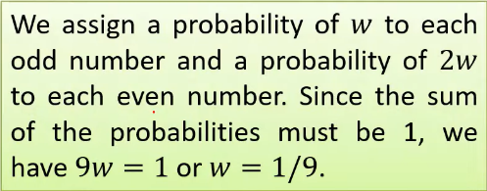
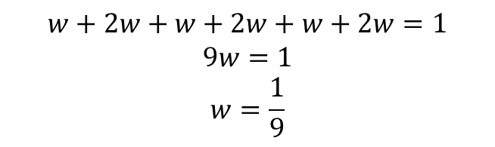

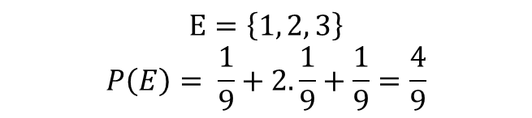
Solution
$S=\left\{1, 2, 3, 4, 5, 6\right\}$
$E=\left\{1, 2, 3\right\}$
The sum of all outcomes must be 1
Outcome | 1 | 2 | 3 | 4 | 5 | 6
P | w | 2w | W | 2w | W | 2w
$$w+2w+w+2w+w+2w=1$$
$$9w=1$$
$$w=\frac{1}{9}$$
$$E=\left\{1, 2, 3\right\}$$
$$P\left(E\right)= \frac{1}{9}+2.\frac{1}{9}+\frac{1}{9}=\frac{4}{9}$$

Slide 21

Conditional Probability
Sometimes the occurrence of one event is affected by the occurrence of another event.
i.e., the probability of event B given that event A has occurred
This is called conditional probability :
$$P\left(B|A\right)$$

Slide 22

definition
This probability is defined as
$$P\left(B|A\right)=\frac{P(A∩B)}{P(A)}$$
where $P\left(A\right)>0$
as we know that event $A$ has occurred
From the formula above we can say:
$$P(A∩B) =P\left(B|A\right)P(A)$$
$P\left(A∩B\right)$is the probability that event A and event B happen at the same time
The calculation depends on whether $A$ and $B$ are independent or dependent events

Slide 23

Independent Events
the occurrence of one event does not affect the occurrence of the other.
Therefore, the probability of both A and B occurring can be found by multiplying their probabilities
$$P(A∩B) =P\left(A\right)×P(B)$$
$$P\left(B|A\right)=P(B)$$
$$P\left(A|B\right)=P(A)$$

Slide 24

Example
in an experiment of rolling a die two times,
event A: having 1 in the first roll
event B having 1 in the second roll
Find $P\left(B|A\right)$
$$P\left(B|A\right)=\frac{P(A∩B)}{P(A)}$$
$$P\left(A\right)=\frac{1}{6}$$
Since these are independent events,
$$P(A∩B) =P\left(A\right)×P(B)$$
$$P\left(A∩B\right)=\frac{1}{6}×\frac{1}{6}=\frac{1}{36}$$
$$P\left(B|A\right)=\frac{\frac{1}{36}}{\frac{1}{6}}=\frac{1}{6}=P(B)$$

Slide 25

Dependent Events
In dependent events the occurrence of one event affects the occurrence of another
in this case the intersection of both events is given by
$$P(A∩B) =P\left(B|A\right)×P(A)$$

Slide 26

Example 1
Suppose you have a box containing 3 red balls and 2 green balls.
You are going to draw two balls from the box one after the other without replacement.
We will define two events:
Event A: The first ball drawn is red.
Event B: The second ball drawn is green.
Find $P(A∩B)$ joint probability

Slide 27

Solution
back to our equation
$$P\left(B|A\right)=\frac{P(A∩B)}{P(A)}$$
the probability of drawing red ball => $P\left(A\right)=\frac{3}{5}$
it is clear that these events are dependent upon each other
$$P(A∩B) =P\left(B|A\right)×P(A)$$
since A already occurred then we left with 2 red balls and 2 green balls so
$P\left(B|A\right)$ = $\frac{2}{4}$ and $P(A)$ is $\frac{3}{5}$ therefor $P\left(A∩B\right)=$ $\frac{2}{4}×\frac{3}{5}=\frac{6}{20}=\frac{3}{10}$

Slide 28
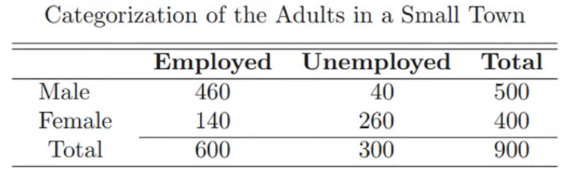

Example 2
Suppose that we have a population of adults who graduated from a university. and they are distributed as follows (table below)
If one of them is selected randomly, what is the probability that he is male given that he is employed $P\left(M|E\right)$

Slide 29

Cont.
$$P\left(M|E\right)=\frac{P(M∩E)}{P(E)}$$
We need to find the joint probability, the same events happen at the same time
$$P\left(M∩E\right)=\frac{460 \# num of employed males}{900 totla number of graduated students}$$
Now we need to find the probability of being employed
$$P\left(E\right)=\frac{600 \# num of employed}{900 totla number of graduated students}$$
$$P\left(M|E\right)=\frac{\frac{460}{900}}{\frac{600}{900}}=\frac{460}{600}$$

Slide 30
Example 3
Consider an industrial process in the textile industry in which strips of a particular type of cloth are being produced. These strips can be defective in two ways, length and nature of texture. It is known from historical information on the process that 10% of strips fail the length test, 5% fail the texture test, and only 0.8% fail both tests.
If a strip is selected randomly from the process and a quick measurement identifies it as failing the length test, what is the probability that it is texture defective?

Slide 31

Solution
$$P\left(L\right)=0.1$$
$$P\left(T\right)=0.05$$
$$P\left(L∩T\right)=0.8\%=0.008$$
Required $P\left(T|L\right)$
$$P\left(T|L\right)=\frac{P\left(L∩T\right)}{P\left(L\right)}=\frac{0.008}{0.1}=0.08$$

Slide 32

Example 4
A die rolled twice, what is the probability that their sum is equal to 10 given that the first dice recorded 6
$$A=\left\{46, 55, 64\right\}$$
$$B=\left\{61,62,63,64,65,66\right\}$$
$$P\left(B\right)=\frac{6 number of valid outcomes}{36 number of outcomes of rolling 2 die}$$
$$P\left(A∩B\right)=\frac{1 mutual outcomes between the sets}{36 total number of outcomes}$$
$$P\left(A|B\right)=\frac{P\left(A∩B\right)}{P\left(B\right)}=\frac{\frac{1}{36}}{\frac{6}{36}}=\frac{1}{6}$$

Slide 33
examples
Imagine a bag contains 6 red balls and 4 green balls. If two balls are drawn randomly without replacement, what is the probability that the second ball is green given the first ball drawn was red?
Consider a bag with 3 red, 2 blue, and 5 green balls. If you draw a ball, note its color, and then put it back before drawing again, what is the probability of drawing a green ball twice in a row?
A bag with 4 red and 5 green balls. You draw two times with replacement. what is the probability of the second ball being a green ball given that the first ball was red

